Slide 1
Claude Usage Analytics Dashboard

Slide 2
Short description
This project analyzes Claude Code telemetry data to understand:
API usage patterns
Cost distribution
User behavior
Model performance

Slide 3
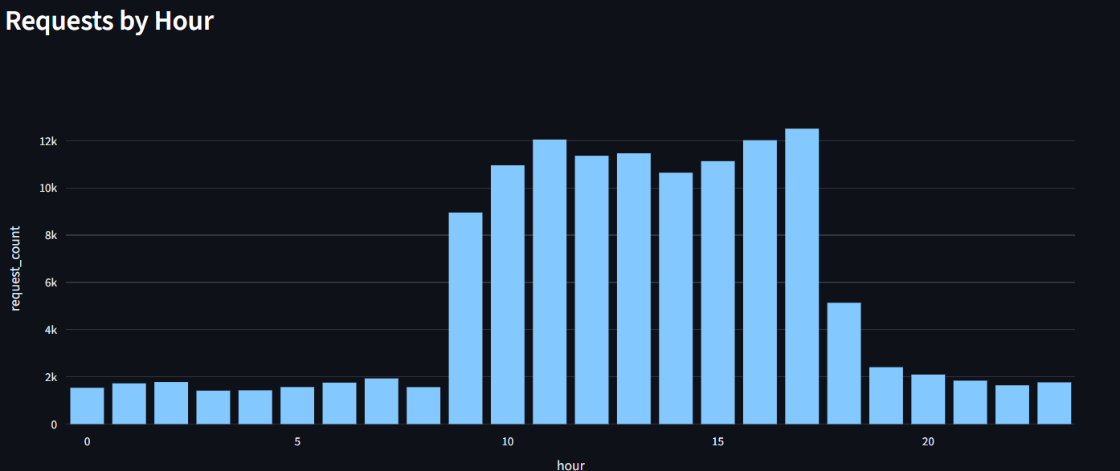
Usage patterns
Usage peaks between 10-18h, which indicates that most developers use the system during standard working hours.

Slide 4
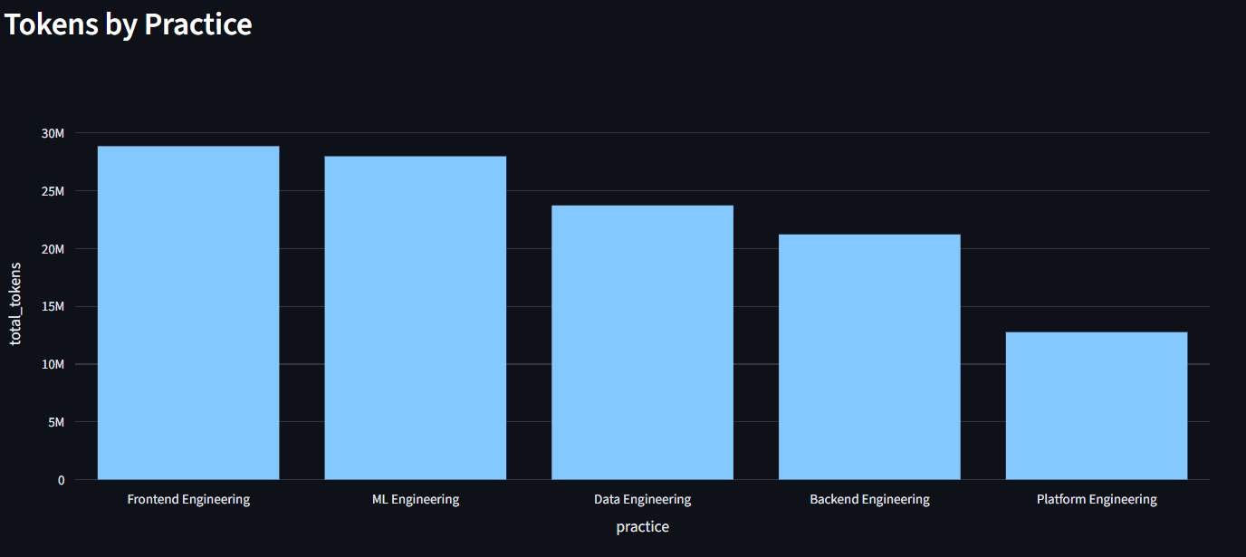
This showwhich indicates that most developers use the system during standard working hours.s that most Frontend Engineers and ML Engineers use Ai

Slide 5
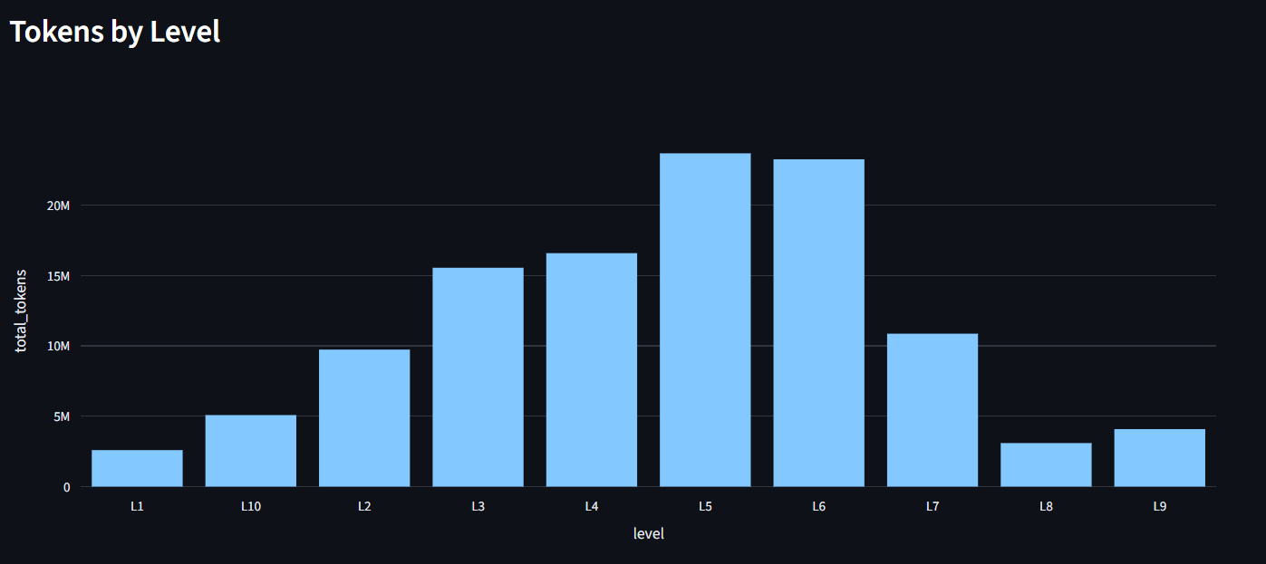
Interestingly, L5–L6 senior engineers use AI the most. I initially expected that junior developers would rely on AI more frequently.

Slide 6
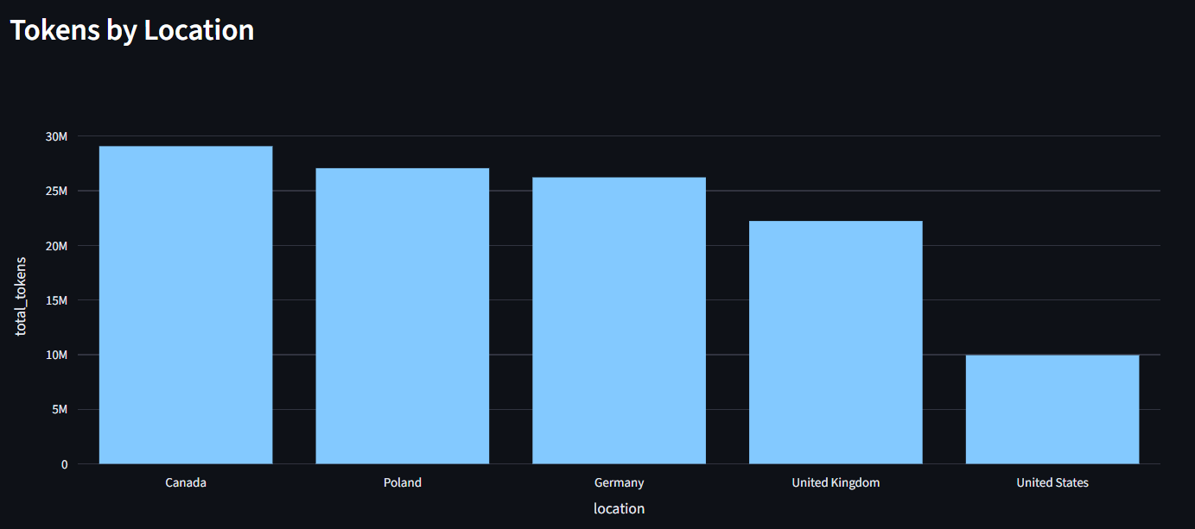
The data also suggests that most employees are located in Canada, Poland, and Germany.

Slide 7
In this assignment, I chose to focus only on the api_request log events, as they contain the most relevant and valuable information for analyzing usage, cost, and performance.
As a potential future improvement, the dashboard could be extended to include api_error events, enabling additional insights into system reliability and failure patterns.

